Slide 1

Predicting Diabetes onset:
A Machine Learning Journey
Group Members:
Temitope,
Kajaananan,
Tamunosaki,
Kaiser
Esala

Slide 2
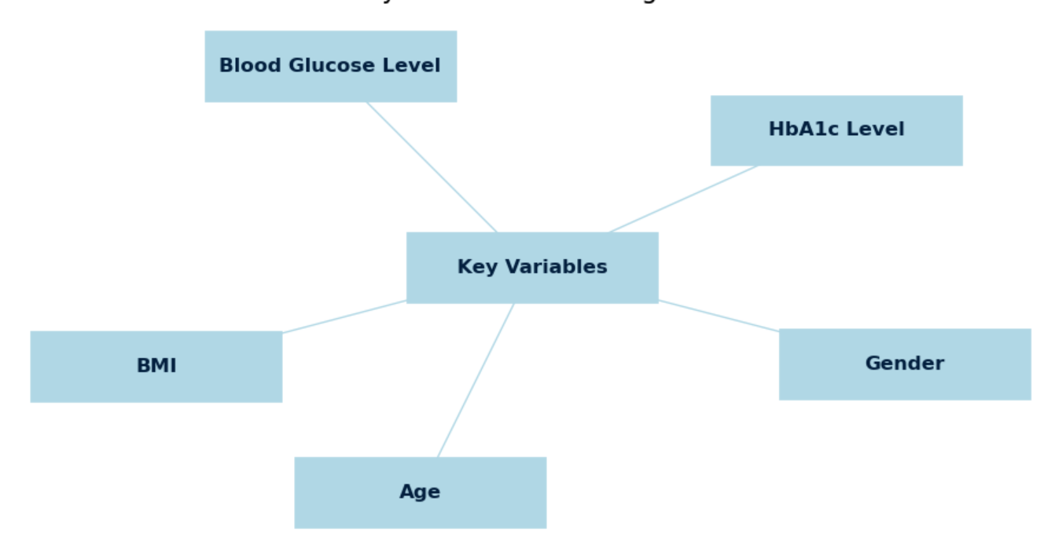
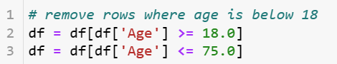
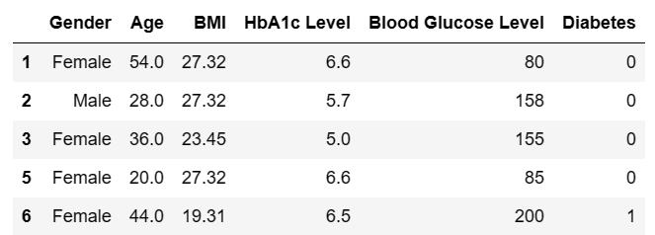
Introduction:
Project Objective: Develop a machine learning model for predicting diabetes.
Key variables include:
Gender.
Age
Body Mass Index (BMI).
HbA1c Level.
Blood Glucose Level
Focus on males and female patients aged between 18 to 75 years.
1

Slide 3
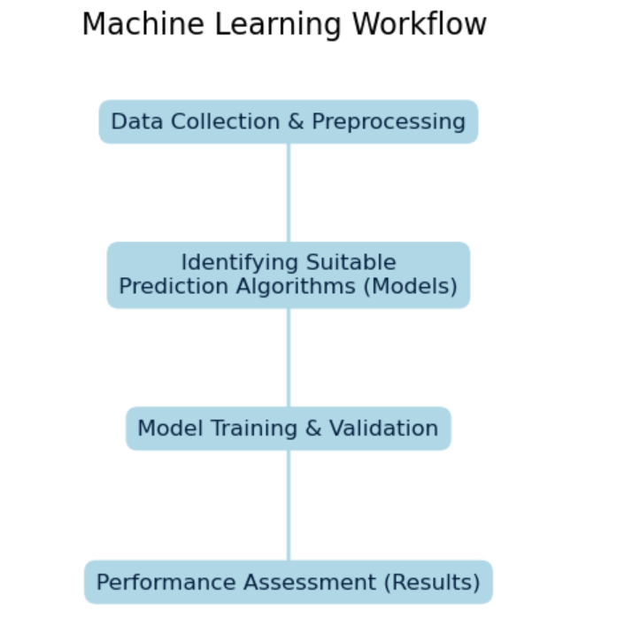
Introduction:
We defined our machine learning workflow in 4 stages:
Data Collection & Preprocessing of Data
Identifying Suitable Prediction Algorithms (Models)
Model Training & Validation
Performance Assessment (Results)
2

Slide 4
Data Collection & Preprocessing of Data
3

Slide 5
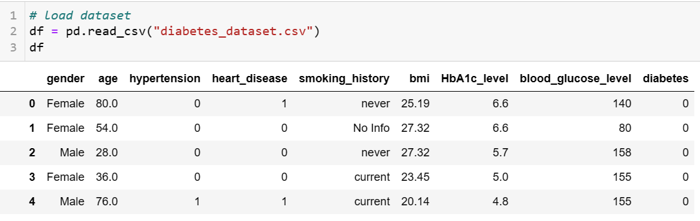
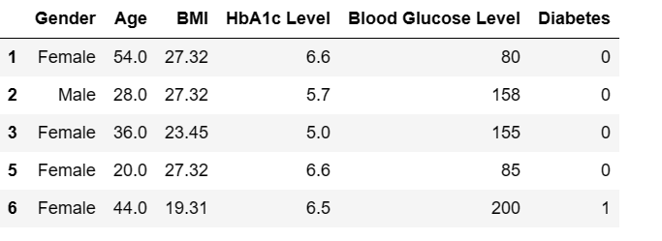
Preprocessing of Data
Renaming and standardizing
Handling Missing Values
Dropping rows with missing values to ensure data quality
Filtering Data Based on Age
4

Slide 6
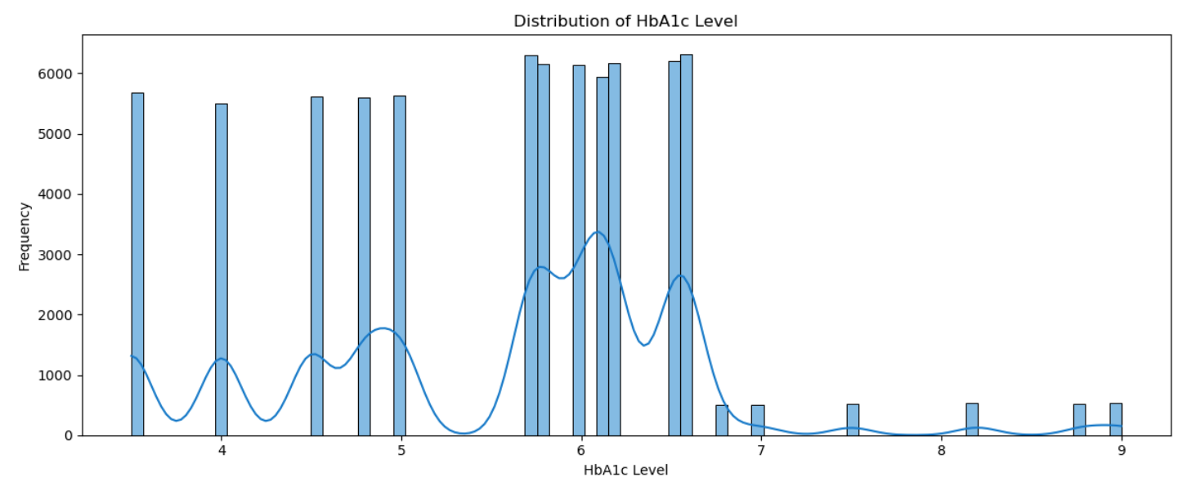
Characteristics of the Dataset
This sub section will provide some characteristics of the dataset used in the project.
Distribution of HbA1c Level
The majority of the dataset falls between 2 and 6.5.
A smaller proportion represents levels over 6.5, implying that a large proportion of the dataset is non-diabetic or prediabetic.
The curved line shows the average level in the distribution.
5

Slide 7
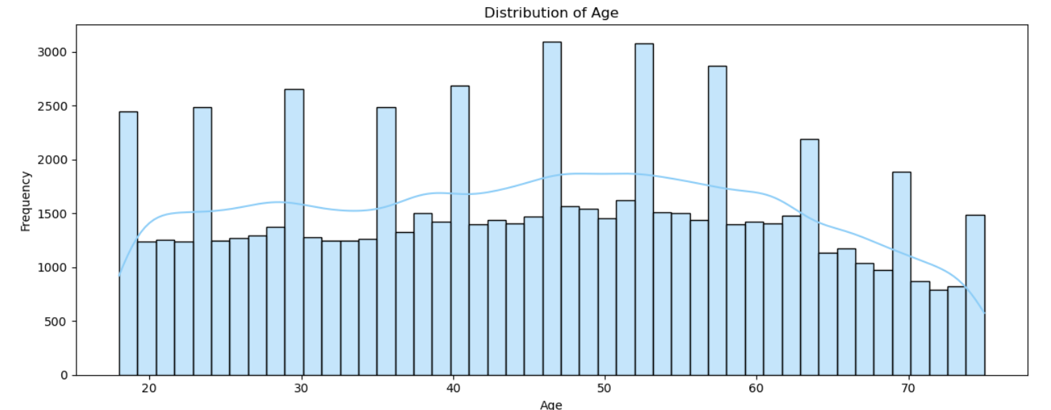
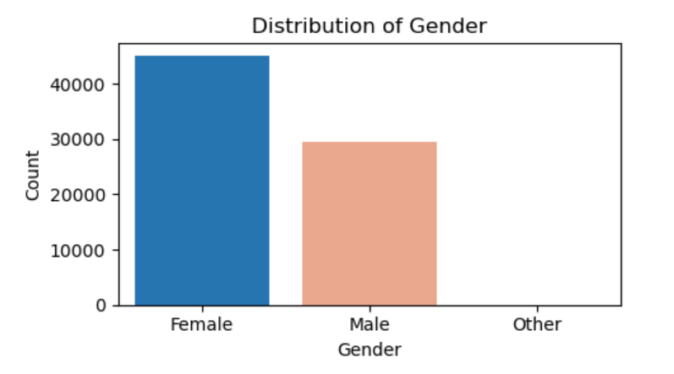
Characteristics of the Dataset .
Age-Frequency Histogram
The histogram displays the distribution of ages in the dataset.
The blue line represents a smoothed curve that illustrates the continuous distribution of ages in the data.
Although there are outliers, all ages between 18 and 75 are well-represented.
Gender Distribution Chart
Females dominate the dataset.
A negligible proportion of the individuals in the dataset did not mention their gender.
6

Slide 8
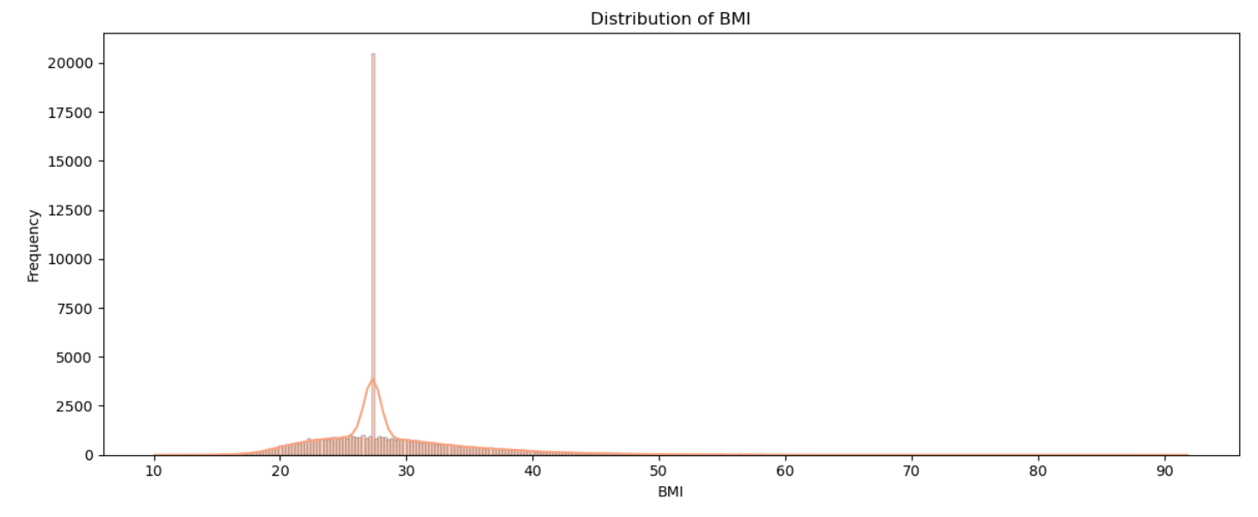
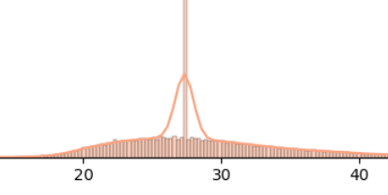
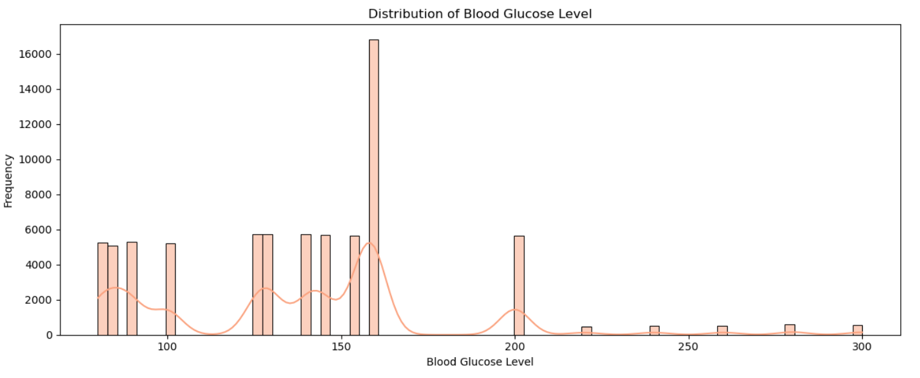
Characteristics of the Dataset
BMI-Frequency Histogram
It is approximately normally distributed, although a single outlier bin appears in the centre.
The curved line shows the smoothed estimation of BMI, indicating a peak at the centre due to the outlier
Distribution of Blood Glucose Chart
A large proportion of the dataset consists of blood glucose levels between 50 and 200.
The proportion of the dataset with blood glucose levels over 200 is very small.
7

Slide 9
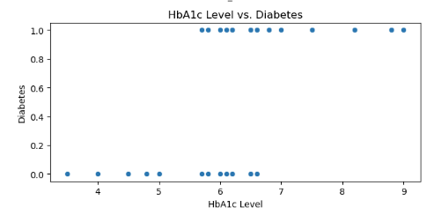
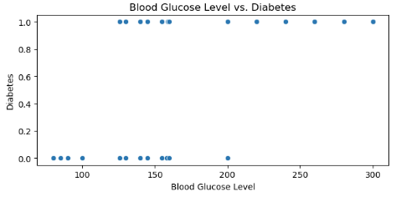
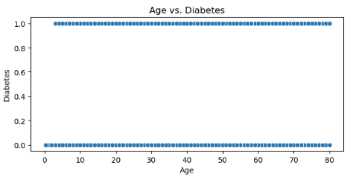
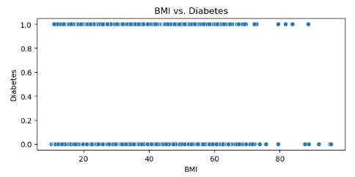
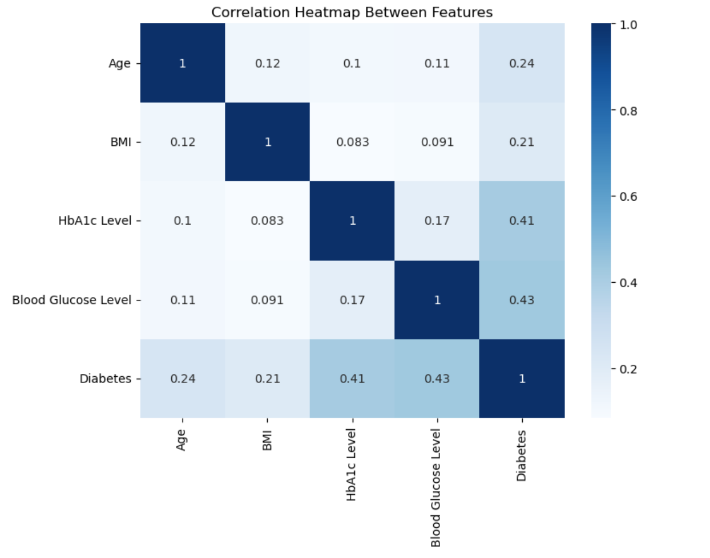
Relationships
Scatter plots
The scatter plots of features show no visual correlation between each other, indicating no linear relationship.
Heatmaps
The heatmap provides detailed numerical values of correlation for each pair of features.
The highest correlation is between blood glucose and diabetes, while the lowest correlation is between BMI and HbA1c.
There are no negative correlations, but some correlations can be negligible.
8

Slide 10
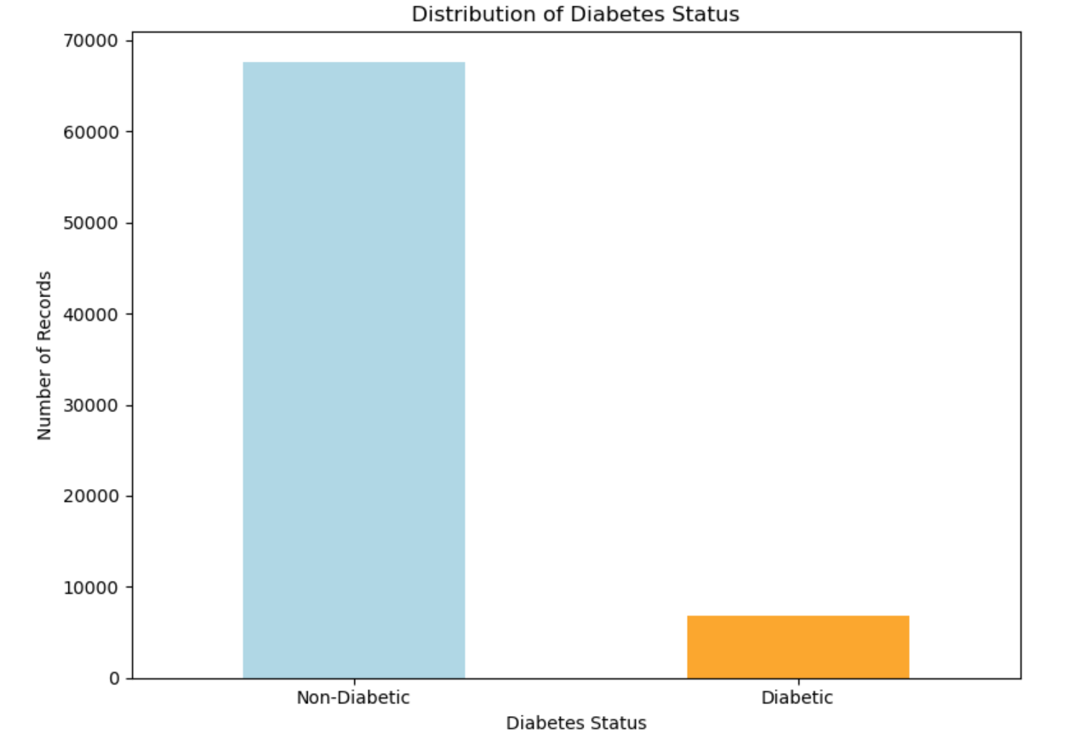
Cleaned Diabetes Data
The chart displays the distribution of data between the diabetic and non-diabetic populations in the dataset.
After cleaning the dataset and selecting the age group 18-75, it appears to be unbalanced.
However, this unbalanced dataset appears to be a true representation of real-life data.
This dataset suggests that efforts should be made to reduce the significant gap before training the data.
9

Slide 11
Identifying Suitable Prediction Algorithms (Models)
10

Slide 12
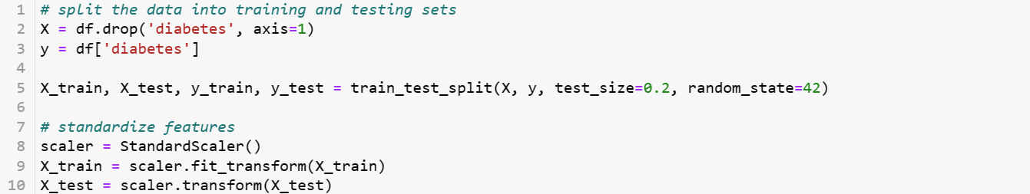
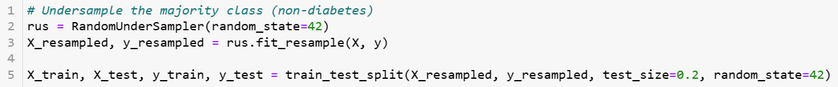
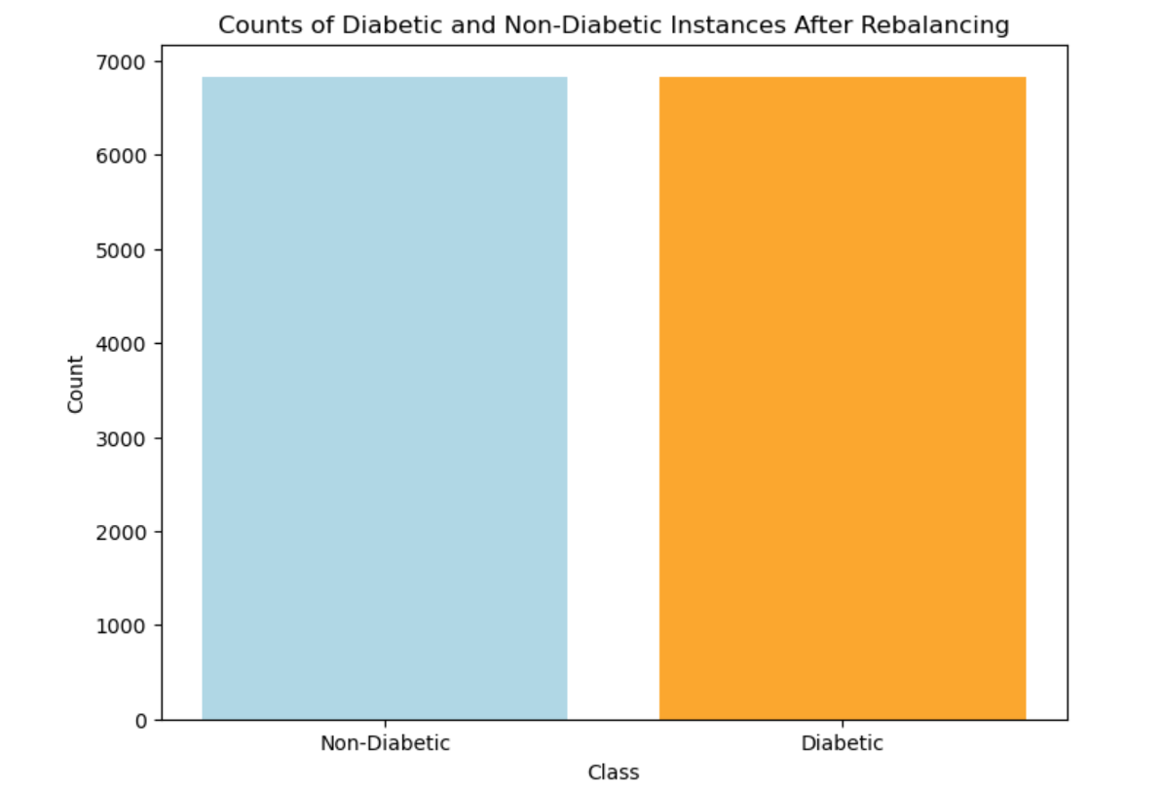
Preparation of Training Data
Split the dataset into training and test sets.
80% for training and 20% for testing.
Feature Scaling using StandardScaler to narrow the gap between the number of diabetic and non-diabetic samples.
RandomUnderSampler balances class distribution by randomly down sampling the majority class
11

Slide 13
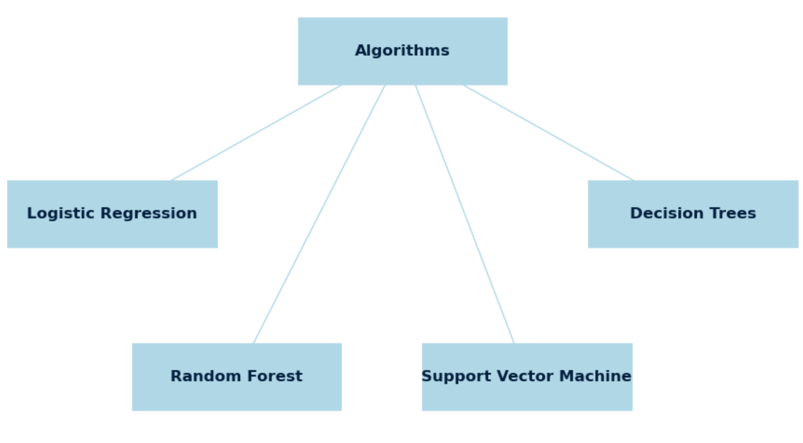
Possible Algorithms
We select four possible algorithms to train data to predict diabetes
Logistic Regression
Random Forest
Support Vector Machine
Decision trees
We Train the model
Make predictions
Evaluate Model
12

Slide 14
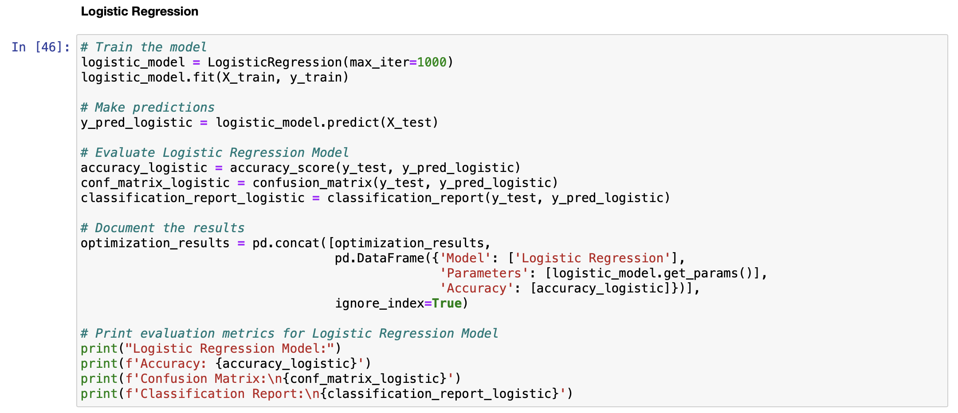
Logistic Regression
Model Training:
Utilized Logistic Regression algorithm for training the model.
Set a maximum iteration limit of 1000 during the training process.
Prediction:
Generated predictions using the trained Logistic Regression model on the test dataset.
Model Evaluation:
Assessed the performance of the Logistic Regression model.
Calculated accuracy, confusion matrix, and classification report metrics.
Results Documentation:
Documented the results, including model parameters and accuracy, in a DataFrame for further analysis and presentation.
13

Slide 15
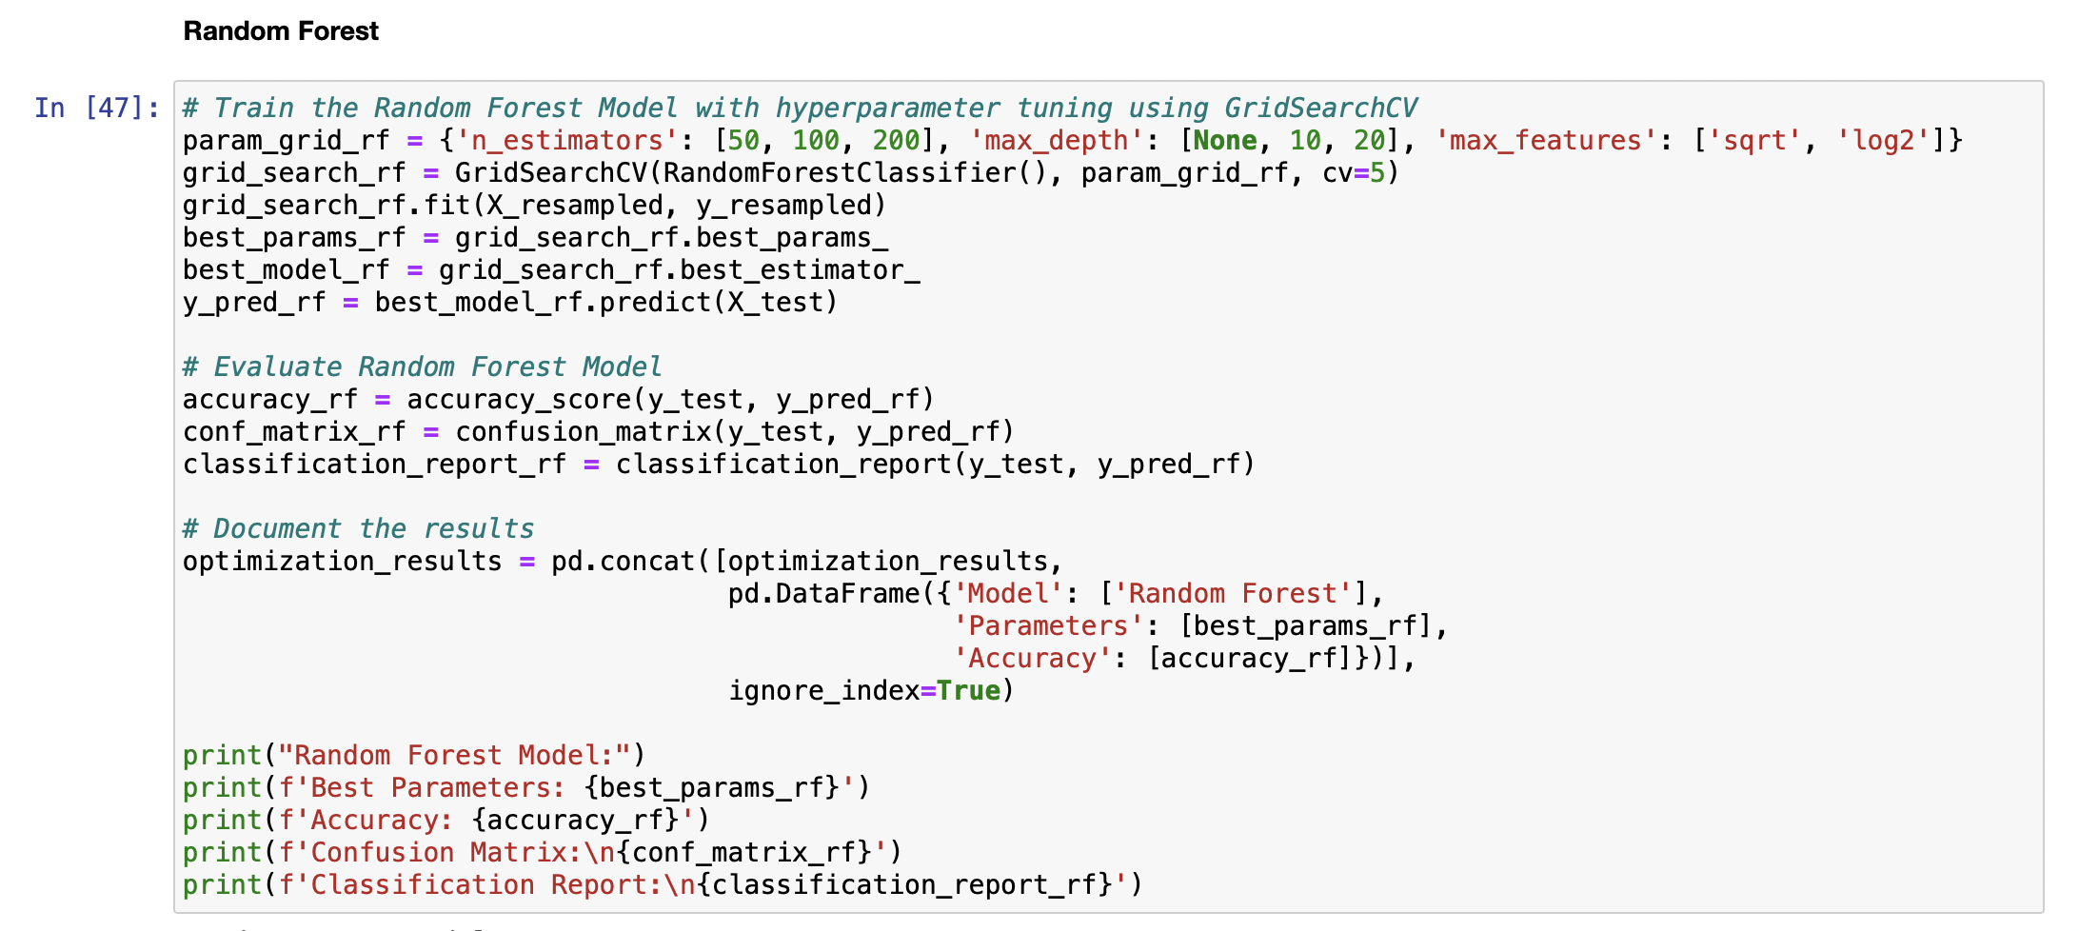
Random Forest Classifier
Model Training with Hyperparameter Tuning:
Utilized the Random Forest Classifier.
Applied hyperparameter tuning using GridSearchCV to find optimal parameters.
Explored various combinations for the number of estimators, maximum depth, and maximum features.
Best Model and Parameters:
Identified the best parameters for the Random Forest model through the GridSearchCV process.
Captured the best Random Forest model with the optimal set of hyperparameters.
Model Evaluation:
Assessed the performance of the Random Forest model on the test dataset.
Calculated accuracy, confusion matrix, and classification report metrics.
Results Documentation:
Documented the results, including the best parameters and accuracy, in a DataFrame for further analysis and presentation.
14

Slide 16
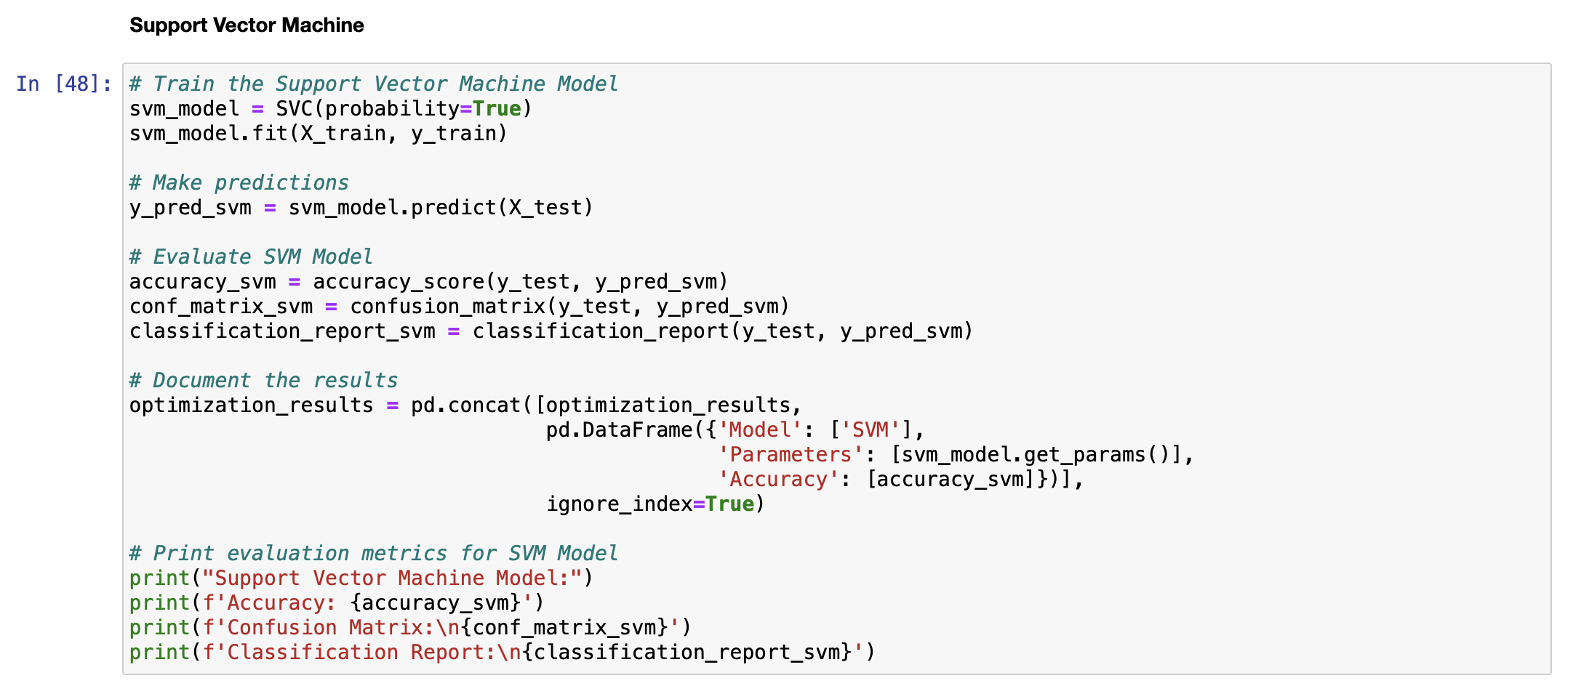
Support Vector Model
Training the Model:
Employed Support Vector Machine (SVM) algorithm for predicting diabetes.
Trained the model on the training dataset using default parameters.
Making Predictions:
Utilized the trained SVM model to make predictions on the test dataset.
Obtained the predicted outcomes for further evaluation.
Evaluation Metrics:
Assessed the performance of the SVM model using key metrics.
Calculated accuracy, confusion matrix, and a detailed classification report.
Results Documentation:
Documented the SVM model details in the optimization results table.
Captured essential information, including model name, parameters, and achieved accuracy.
15

Slide 17
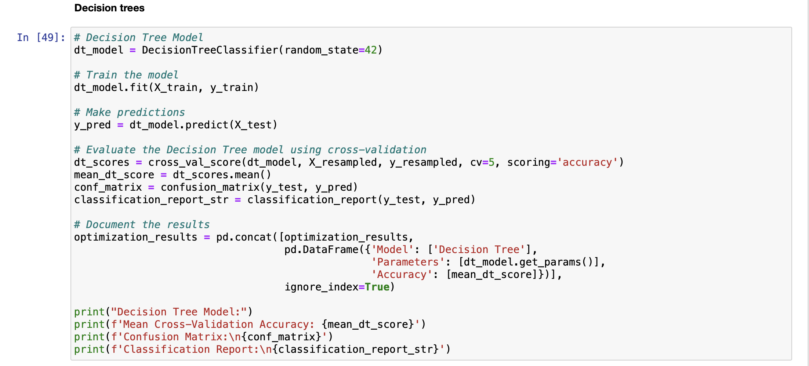
Decision Tree
Training the Model:
Created a Decision Tree model instance with a specified random state for reproducibility.
Trained the Decision Tree model on the resampled training data using the `fit` method.
Making Predictions:
- Generated predictions on the test using the trained Decision Tree model, obtaining the predicted labels.
Model Evaluation:
Conducted cross-validation using the resampled data to obtain a more robust assessment of model performance.
Computed the mean accuracy of the Decision Tree model across cross-validation.
Calculated accuracy, confusion matrix, and a detailed classification report.
Results Documentation:
Documented the SVM model details in the optimization results table.
Captured essential information, including model name, parameters, and achieved accuracy.
16

Slide 18
Results
17

Slide 19
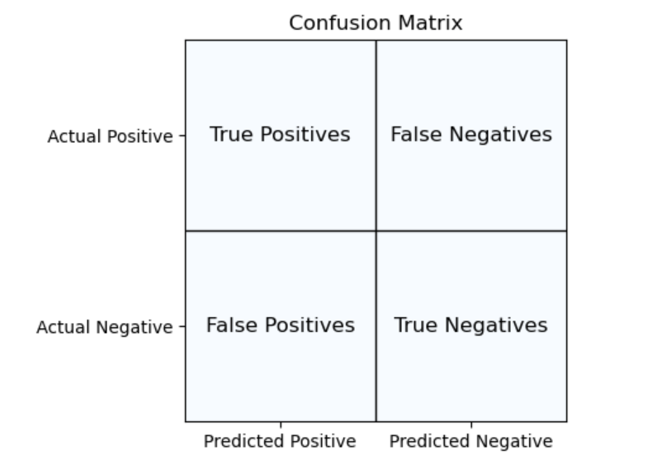
Results
Results from the previous models are presented in two forms: Confusion Matrix and Classification Report.
Elements in confusion matrix:
True Positive (TP): TP is the count of correct positive predictions by the model.
True Negative(TN): is the count of correct negative predictions by the model.
False Positive(FP): is the count of false positive predictions by the model.
False Negative(FN): is the count of false negative predictions by the model.
18

Slide 20
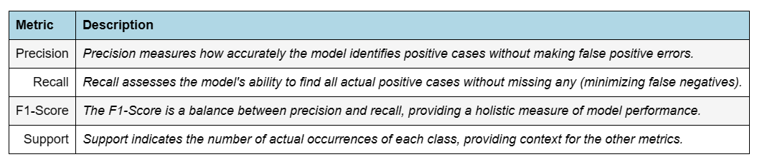
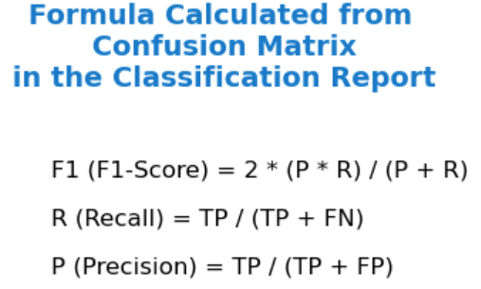
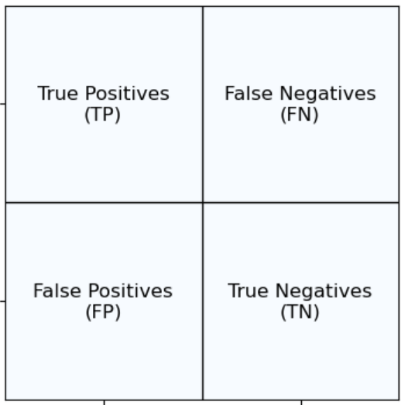
Results
Classification Report
A classification report is a summary of key performance metrics for a classification model
Support: = represents the frequency of each class in the actual data.
Macro avg = treats all classes equally in the calculation.
Weighted avg = considers class sizes when calculating the average.
19

Slide 21
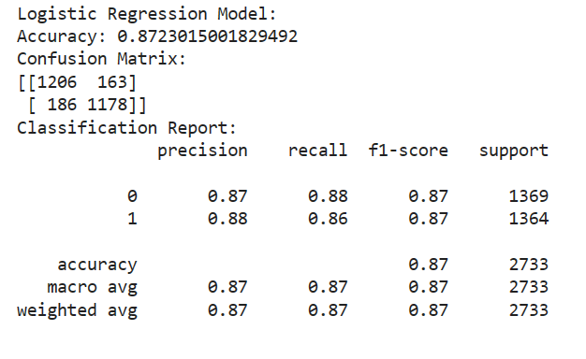
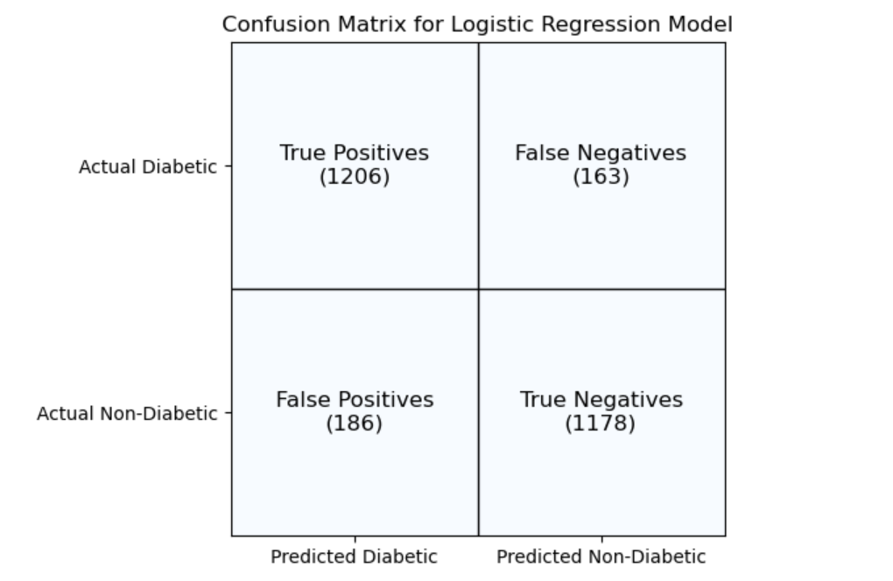
Logistic Regression Model
The model's accuracy is around 87%, reflecting how often it predicts correctly.
The Classification Report presents precision, recall, and F1-score for both classes (0 and 1), with an overall weighted average accuracy of about 87%.
20

Slide 22
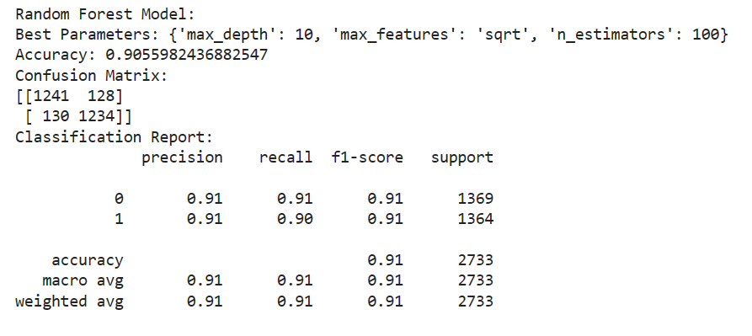
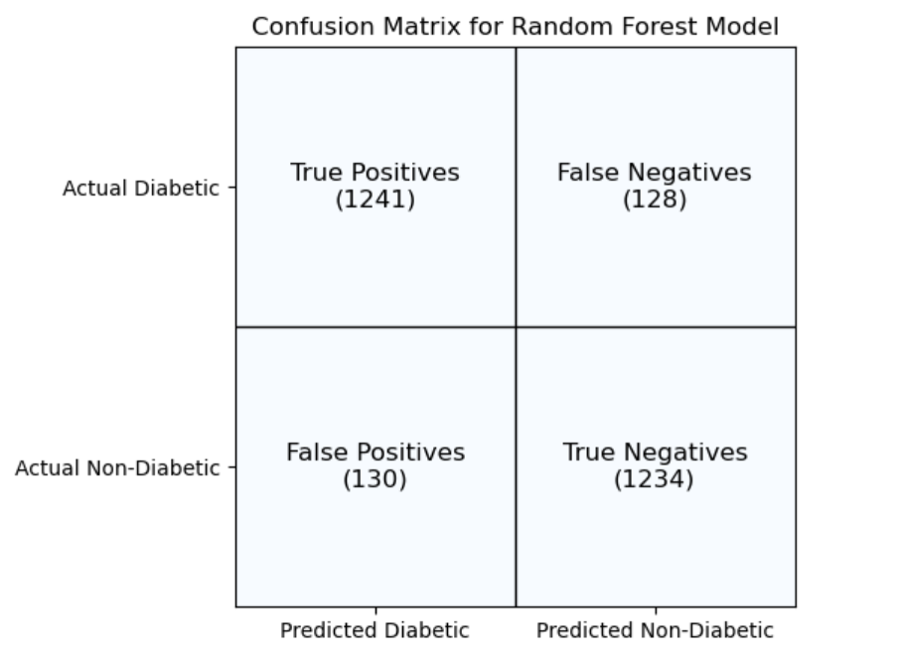
Random Forest Model
The model achieved an accuracy of around 91 %, indicating its prediction correctness.
The Classification Report displays precision, recall, and F1-score for both classes (0 and 1), with an overall weighted accuracy of about 91 %
21

Slide 23
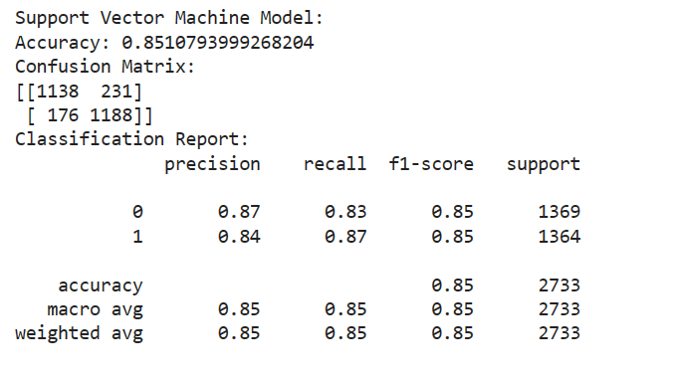
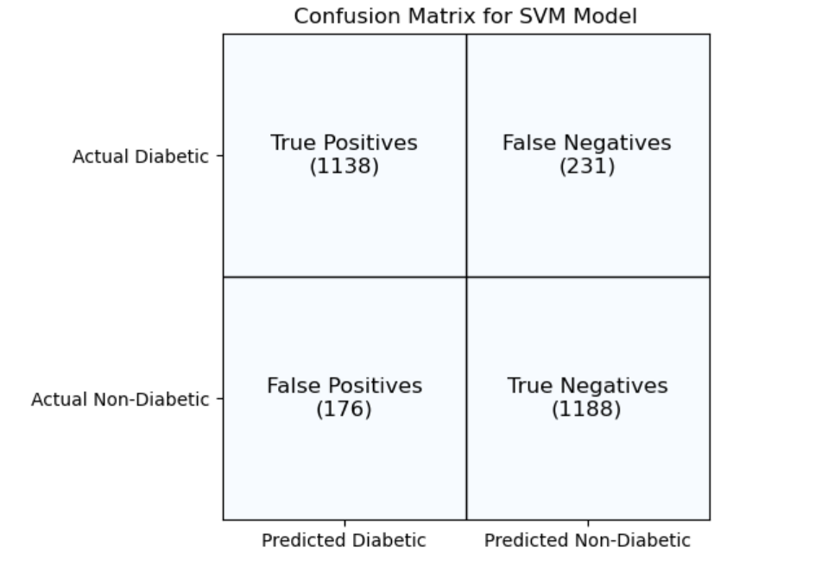
Support Vector Machine Model
Support Vector Machine Model
The model achieved an accuracy of approximately 85 %, reflecting its overall prediction correctness
The Classification Report displays precision, recall, F1-score for classes 0 and 1, with an overall weighted accuracy of about 85 %
22

Slide 24
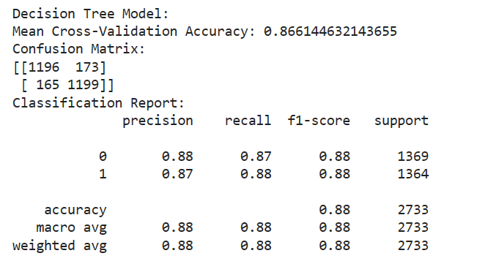
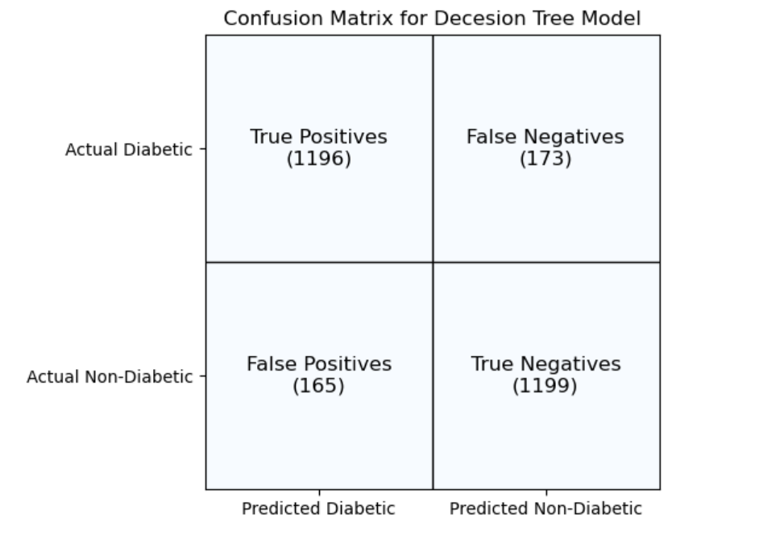
Decision Tree Model
The model achieved an accuracy of approximately 88%, indicating its overall prediction correctness.
The Classification Report displays precision, recall, F1-score for classes 0 and 1, with a weighted average accuracy of about 87%.
23

Slide 25
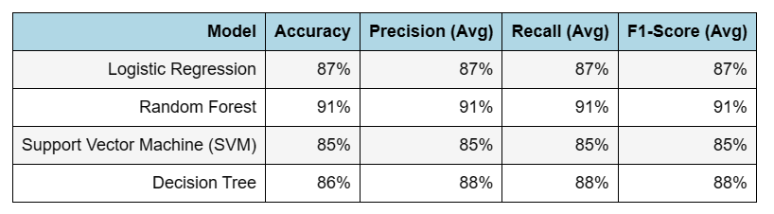
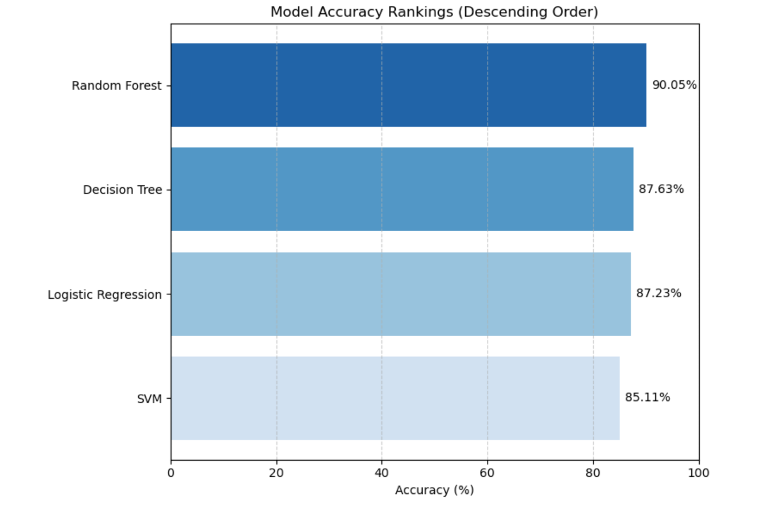
Results Summary
Random Forest had the highest accuracy at 91%, while SVM had the lowest at 85%.
Decision Tree and Logistic Regression achieved 87% and 86% accuracy which are the 2nd and 3rd in ranking.
Overall, Random Forest performed best in accuracy, while Random Forest and Decision Tree demonstrated balanced precision and recall, suitable for classification tasks.
24

Slide 26
Conclusion
25

Slide 27
Results
26

Slide 28
Challenges
Challenges:
The dataset we used for building our models had an imbalance issue, with more records showing negative diabetes statuses
The dataset’s large size slowed down processing making code execution longer
Next Steps
Develop and intuitive and user –friendly interface for easy interaction with the diabetes prediction model.
Conduct through testing in a controlled environment to validate model performance
27

Slide 29
Questions
28

Slide 30
References:
pandas.pydata.org. (n.d.). Styling — pandas 1.1.2 documentation. [online] Available at: https://pandas.pydata.org/pandas-docs/stable/user_guide/style.html.
networkx.org. (n.d.). Gallery — NetworkX 3.2.1 documentation. [online] Available at: https://networkx.org/documentation/stable/auto_examples/index.html [Accessed 23 Jan. 2024].
Jason Brownlee (2018). What is a Confusion Matrix in Machine Learning. [online] Machine Learning Mastery. Available at: https://machinelearningmastery.com/confusion-matrix-machine-learning/.
www.kaggle.com. (n.d.). Diabetes prediction dataset. [online] Available at: https://www.kaggle.com/datasets/iammustafatz/diabetes-prediction-dataset/data
29

